Slide 1
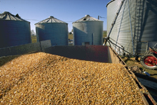
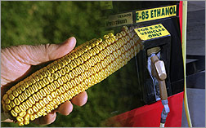
Grain Outlook &
Marketing Considerations
Northwest Iowa Farm Business Association
Annual Meeting
Sheldon, Iowa
March 30, 2009
Chad Hart
Assistant Professor/Grain Markets Specialist
chart@iastate.edu
515-294-9911

Slide 2
U.S. Corn Supply and Use
 |  | 2007 | 2008 | 2009
Area Planted | (mil. acres) | 93.5 | 86.0 | 86.0
Yield | (bu./acre) | 150.7 | 153.9 | 156.9
Production | (mil. bu.) | 13,038 | 12,101 | 12,365
Beg. Stocks | (mil. bu.) | 1,304 | 1,624 | 1,790
Imports | (mil. bu.) | 20 | 15 | 15
Total Supply | (mil. bu.) | 14,362 | 13,740 | 14,170
Feed & Residual | (mil. bu.) | 5,938 | 5,300 | 5,200
Ethanol | (mil. bu.) | 3,026 | 3,700 | 4,100
Food, Seed, & Other | (mil. bu.) | 1,337 | 1,300 | 1,300
Exports | (mil. bu.) | 2,436 | 1,700 | 1,850
Total Use | (mil. bu.) | 12,737 | 12,000 | 12,450
Ending Stocks | (mil. bu.) | 1,624 | 1,740 | 1,720
Season-Average Price | ($/bu.) | 4.20 | 4.10 | 3.60
Source: USDA

Slide 3
U.S. Soybean Supply and Use
 |  | 2007 | 2008 | 2009
Area Planted | (mil. acres) | 64.7 | 75.7 | 77.0
Yield | (bu./acre) | 41.7 | 39.6 | 42.6
Production | (mil. bu.) | 2,677 | 2,959 | 3,240
Beg. Stocks | (mil. bu.) | 574 | 205 | 210
Imports | (mil. bu.) | 10 | 9 | 3
Total Supply | (mil. bu.) | 3,261 | 3,173 | 3,453
Crush | (mil. bu.) | 1,801 | 1,640 | 1,675
Seed & Residual | (mil. bu.) | 93 | 163 | 172
Exports | (mil. bu.) | 1,161 | 1,185 | 1,225
Total Use | (mil. bu.) | 3,056 | 2,988 | 3,073
Ending Stocks | (mil. bu.) | 205 | 185 | 380
Season-Average Price | ($/bu.) | 10.10 | 9.35 | 8.00
Source: USDA

Slide 4
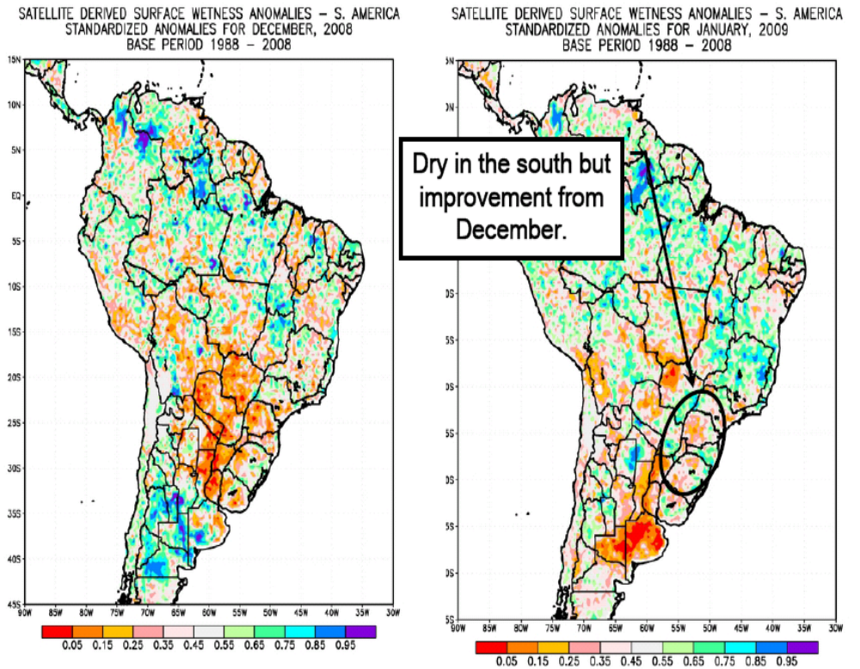
Drought in South America
Source: USDA-WAOB, Feb. 2009

Slide 5
Argentine Drought Impacts
2007 Production
Corn 20.9 million tons
Soybeans 46.2 million tons
January 2009 USDA Estimates
Corn 16.5 million tons -21%
Soybeans 49.5 million tons +7%
Current USDA Estimates
Corn 13.5 million tons -35%
Soybeans 43.0 million tons -7%
January Estimates from Buenos Aires Cereal Exchange (BACE)
Corn 12.3 to 13.7 million tons -35 to -41%
Soybeans 34.5 to 38.2 million tons -17 to -25%
Feb. Estimate from BACE Soy 40 million tons -13%
Source: USDA, Dow Jones Newswires

Slide 6
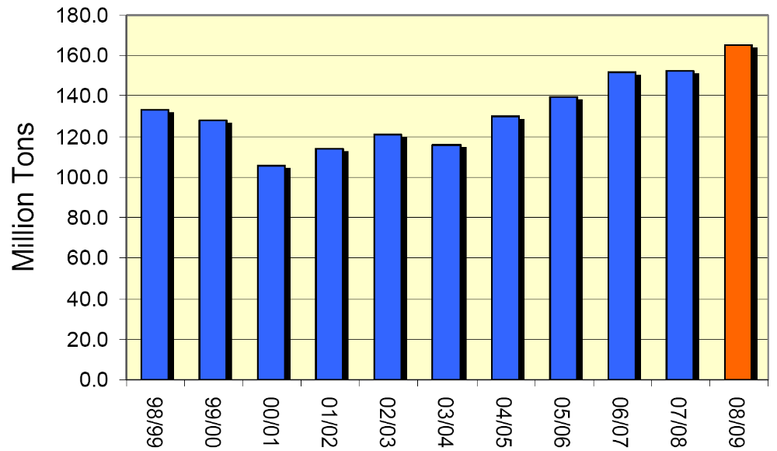
Chinese Corn Production
Source: USDA-WAOB, Jan. 2009

Slide 7
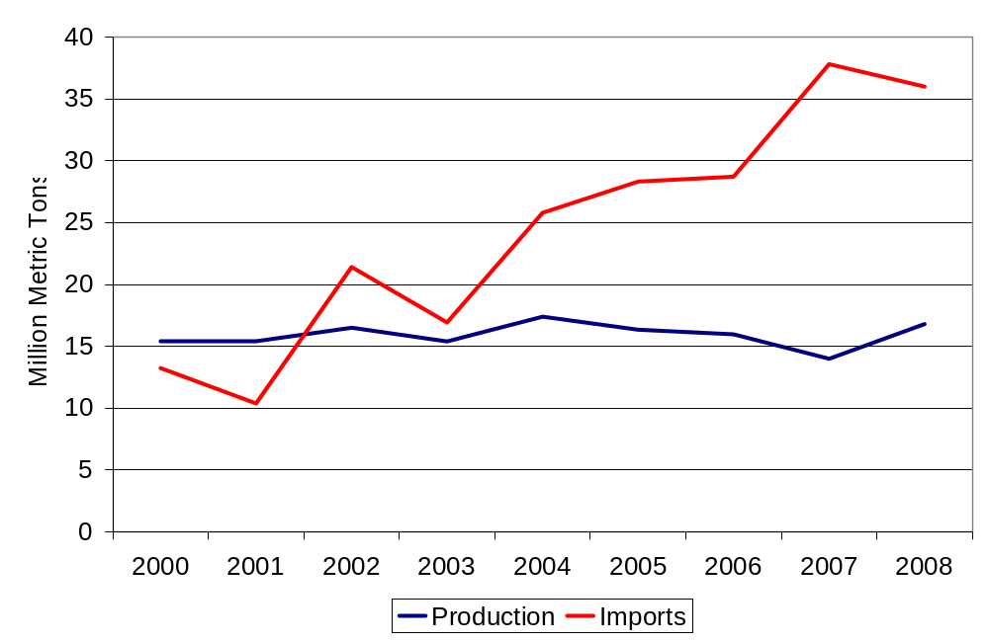
Soybeans in China
Source: USDA-PSD, Jan. 2009

Slide 8
Livestock Adjustments
Sows farrowing:
Sept-Nov 2008 2.99 million, 6% from last year
Dec-Feb 2009 2.98 million, 3% from last year
Mar-May 2009 2.96 million, 3% from last year
Broiler-type eggs set: 203 million, 7% from last year
Broiler chicks placed: 169 million, 6% from last year
Cattle and calves on feed: 11.2 million, 5% from last year
Sources: Various USDA-NASS reports
Notes:
Livestock consolidation is underway and with it comes lower feed demand. The recent reduction in crop prices can help ease consolidation pressure, but the economic weakness is also taking its toll on meat demand.

Slide 9
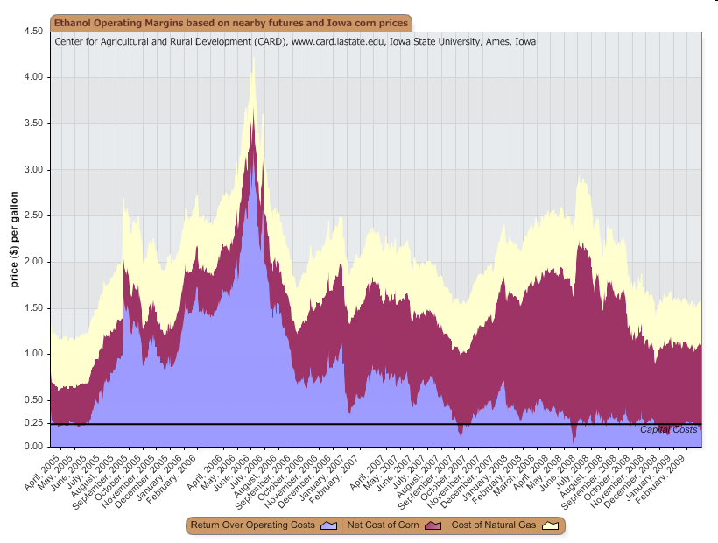
Ethanol Margins
Source: ISU, CARD

Slide 10
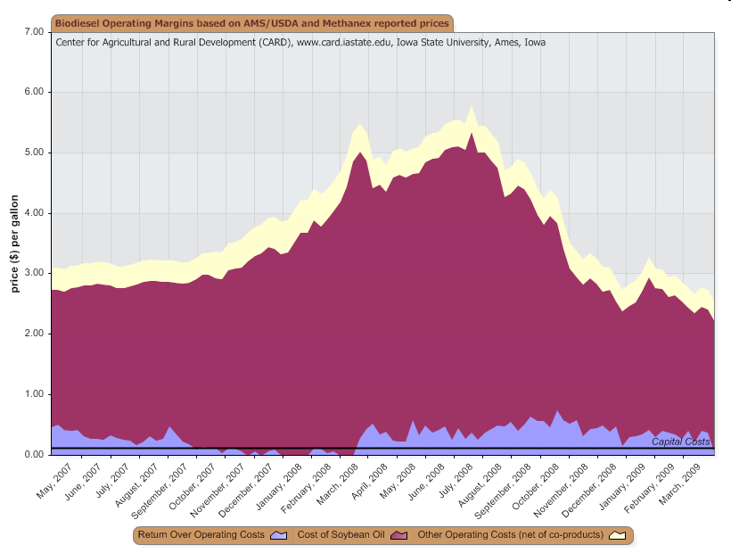
Biodiesel Margins
Source: ISU, CARD

Slide 11
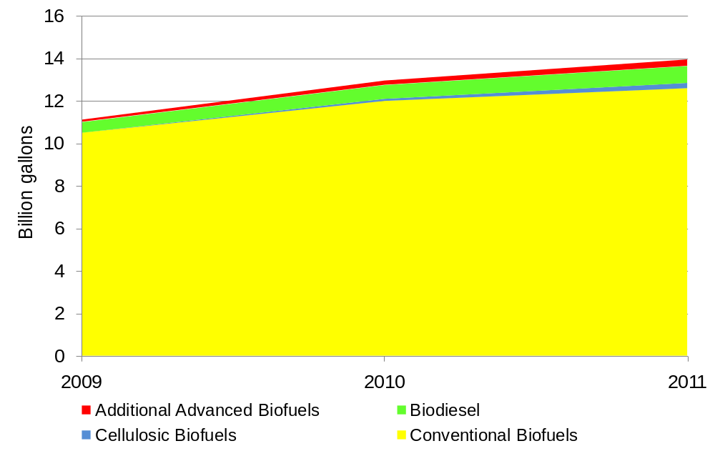
Renewable Fuels Standard (RFS)
Crop Year | Billion Bushels
2008 | 3.57
2009 | 4.11
2010 | 4.43
Notes:
Corn-based ethanol goes in as conventional biofuel. The tables show the amounts of corn needed to meet the conventional biofuel portion of the RFS with corn-grain ethanol. The Renewable Fuels Association lists current ethanol production capacity at 10.95 billion gallons, with another 2.8 billion gallons under construction. So ethanol capacity is large enough to meet the RFS for the next few years. 2009 is the 1st year for the biodiesel portion of the RFS, with 500 million gallons of biodiesel needed to meet the mandate. In 2007, we produced roughly 450 million gallons. And the U.S. has enough biodiesel capacity on the ground today to produce over 2 billion gallons of biodiesel from a variety of sources.

Slide 12
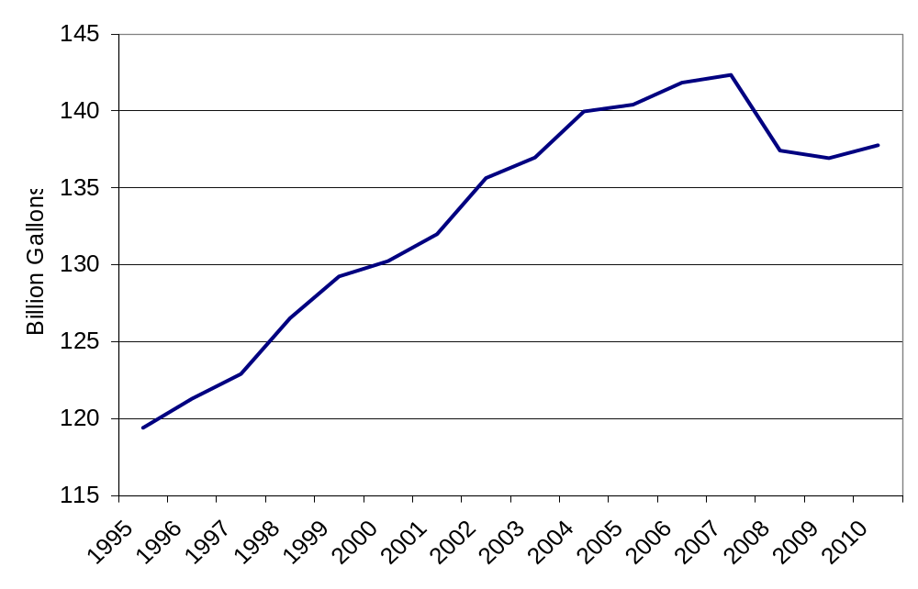
U.S. Blended Motor Gasoline Consumption
Source: Energy Information Administration
Notes:
One of the biggest factors influencing the biofuel industry is the overall usage of fuel. This graph shows the dramatic decline in projected gasoline consumption for this year and next. The higher energy prices earlier this year had a definite impact.

Slide 13
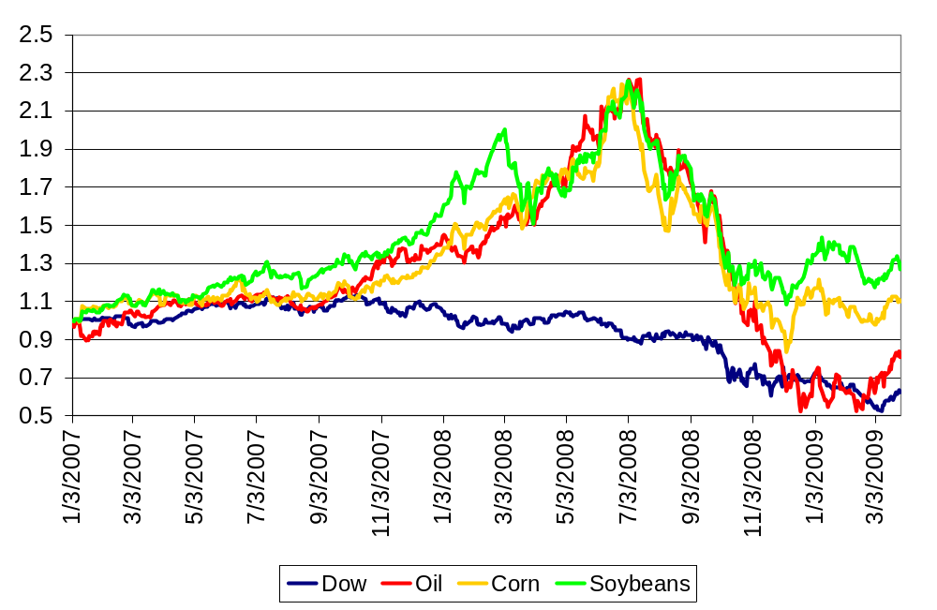
Outside Influences (Jan. 2007 = 1)
Notes:
Agriculture’s link to the energy markets has been a strong one. Corn and soybean prices have tracked with oil prices since late in 2006.

Slide 14
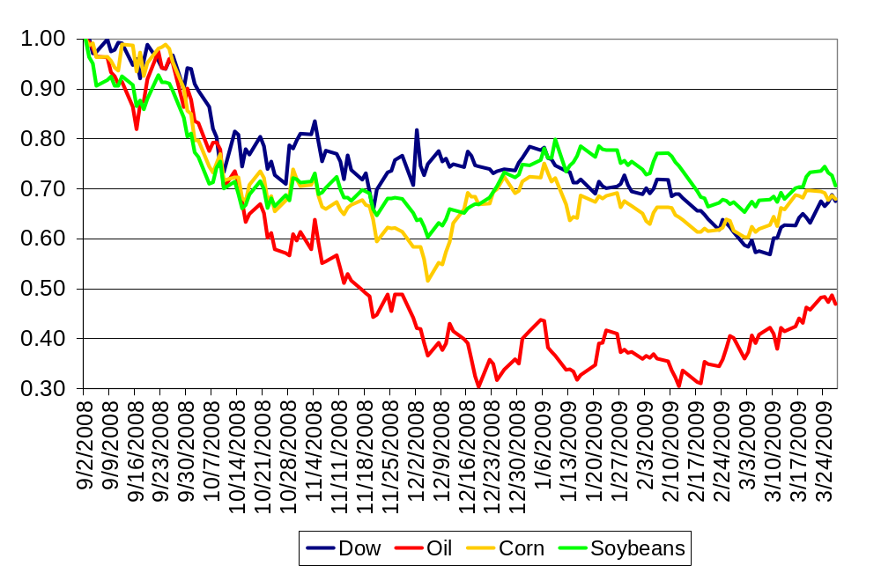
Outside Influences (Sept. 2008 = 1)

Slide 15
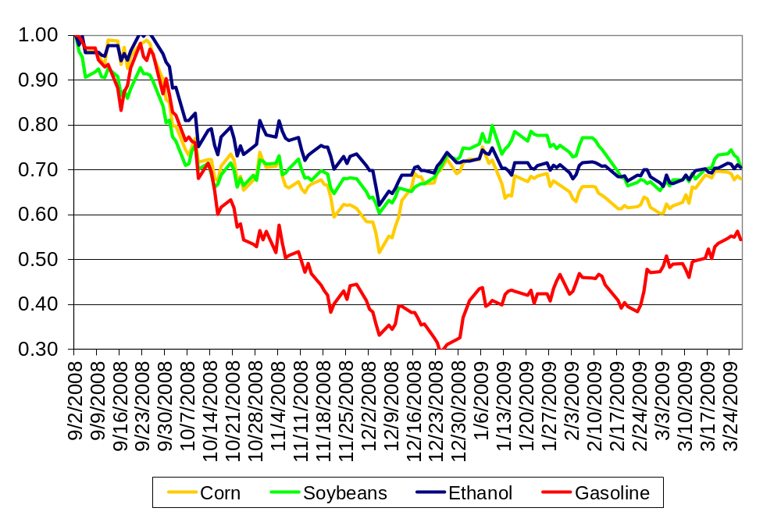
Outside Influences (Sept. 2008 = 1)

Slide 16
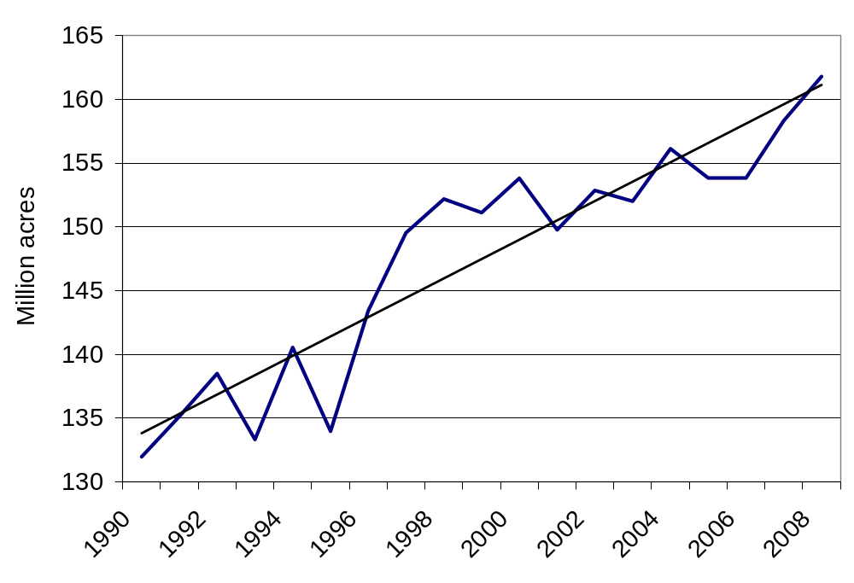
Corn & Soybean Area
Growth rate of 1.55 million acres per year
Notes:
While total land devoted to crop production has been fairly steady over the past few years, the amount of land planted to corn and soybeans has been on the rise. Minor feed grains and cotton have been giving up ground.

Slide 17
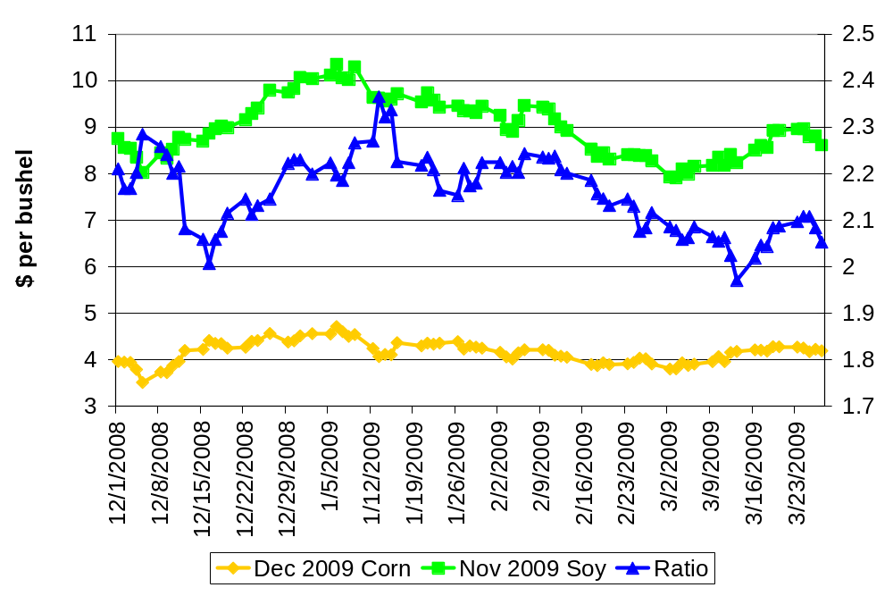
Harvest Futures
Source: CBOT

Slide 18
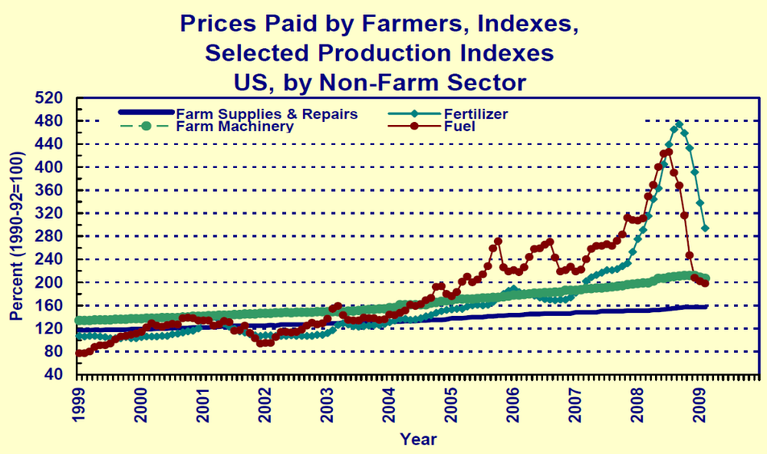
Input Costs
Source: USDA, Agricultural Prices, Feb. 2009

Slide 19
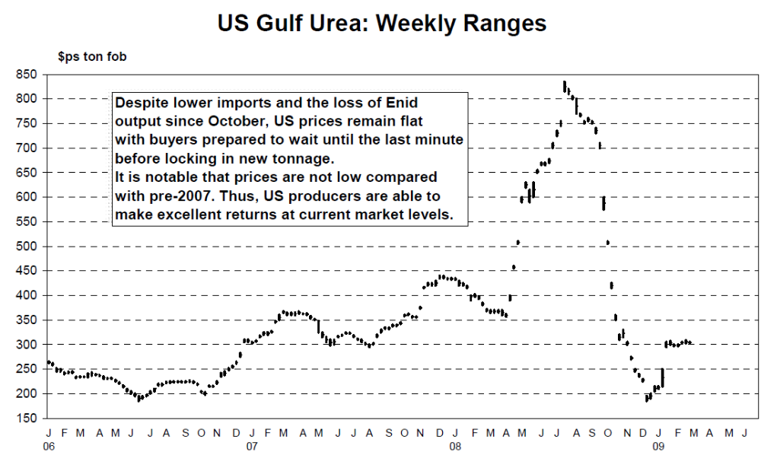
Urea Prices
Source: http://www.fertilizerworks.com/fertreport/
pdf/2008/Profercy-022709pdf.pdf

Slide 20
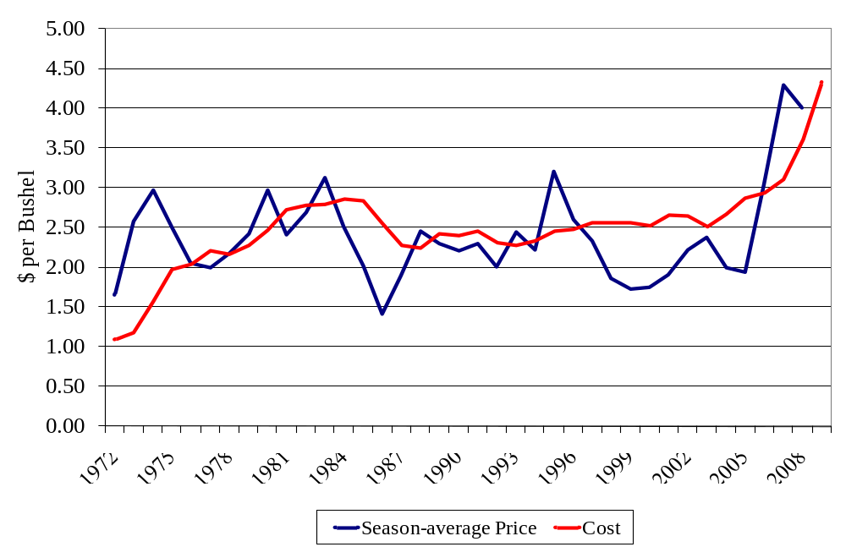
Iowa Corn Prices vs. Costs
Source: USDA-NASS and Duffy and Smith,
http://www.extension.iastate.edu/agdm/crops/pdf/a1-21.pdf
Notes:
Average return over the time period, -7 cents per bushel.

Slide 21
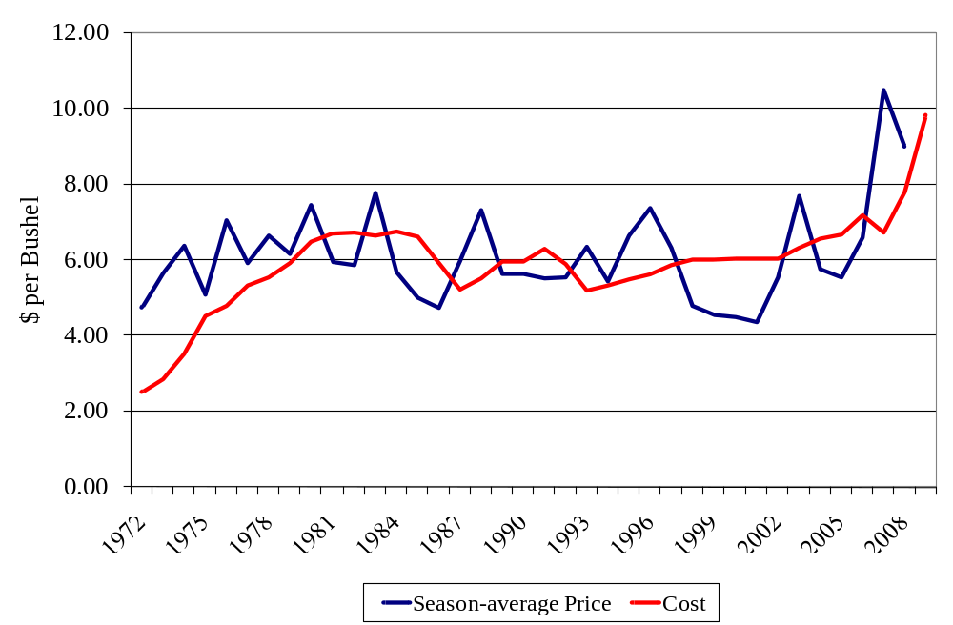
Iowa Soybean Prices vs. Costs
Source: USDA-NASS and Duffy and Smith,
http://www.extension.iastate.edu/agdm/crops/pdf/a1-21.pdf
Notes:
Average return over the period, 31 cents per bushel.

Slide 22
Estimates for 2009 Iowa Costs
Non-land Cost | Land Cost | Total Cost | Expected Yield | Cost per Bushel
($/acre) |  |  | (bu/acre) | ($/bu)
Corn
486.61 | 205.00 | 691.61 | 160 | 4.32
Soybean
285.60 | 205.00 | 490.60 | 50 | 9.81
December 2009 Corn Futures = $4.1925 (3/27/09)
November 2009 Soy Futures = $8.6075 (3/27/09)
Source: Duffy and Smith,
http://www.extension.iastate.edu/agdm/crops/pdf/a1-20.pdf

Slide 23
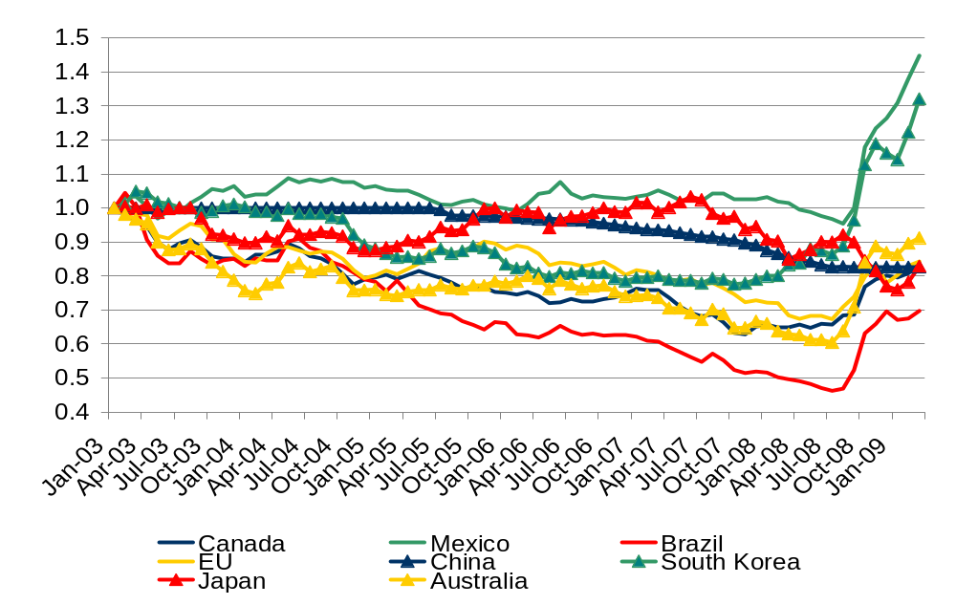
Exchange Rates (Jan. 2003 = 1)
Source: USDA, ERS

Slide 24
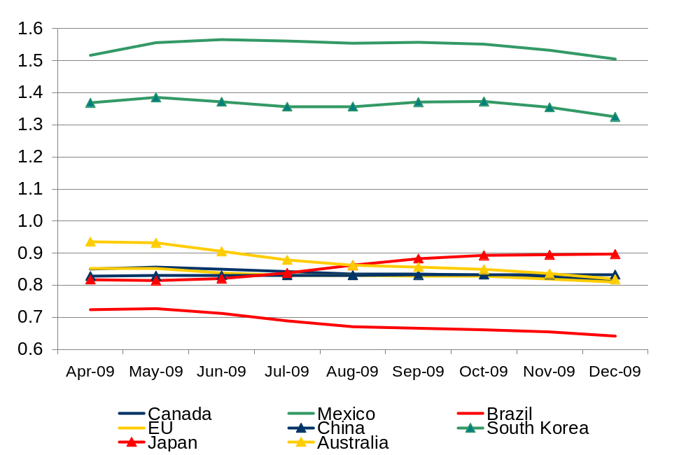
Exchange Rates (Jan. 2003 = 1)
Source: USDA, ERS

Slide 25
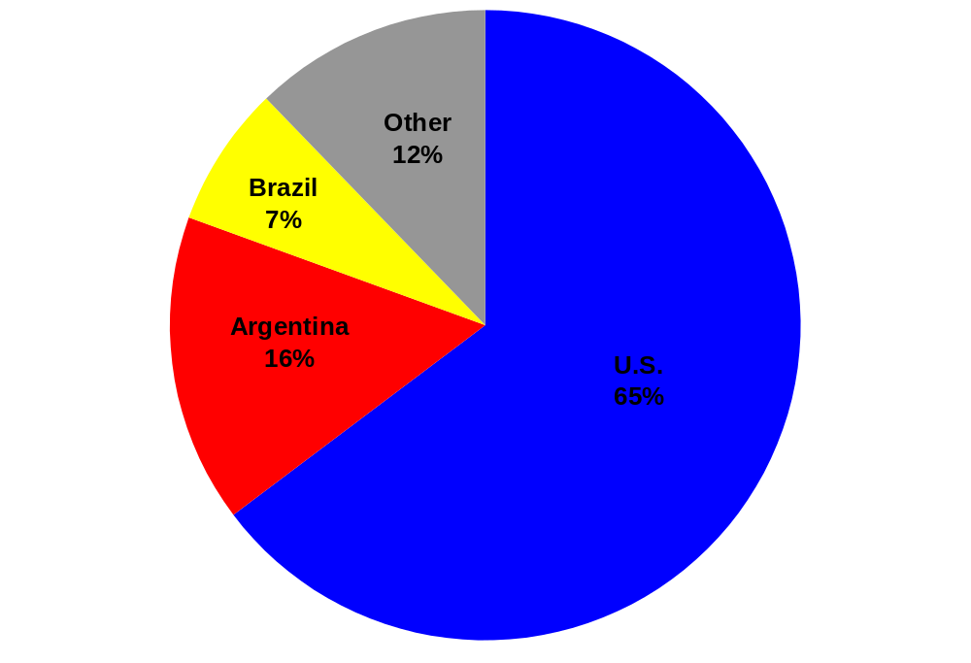
2007 World Corn Exports
Drought issues
for 2008 crops
Source: USDA, FAS

Slide 26
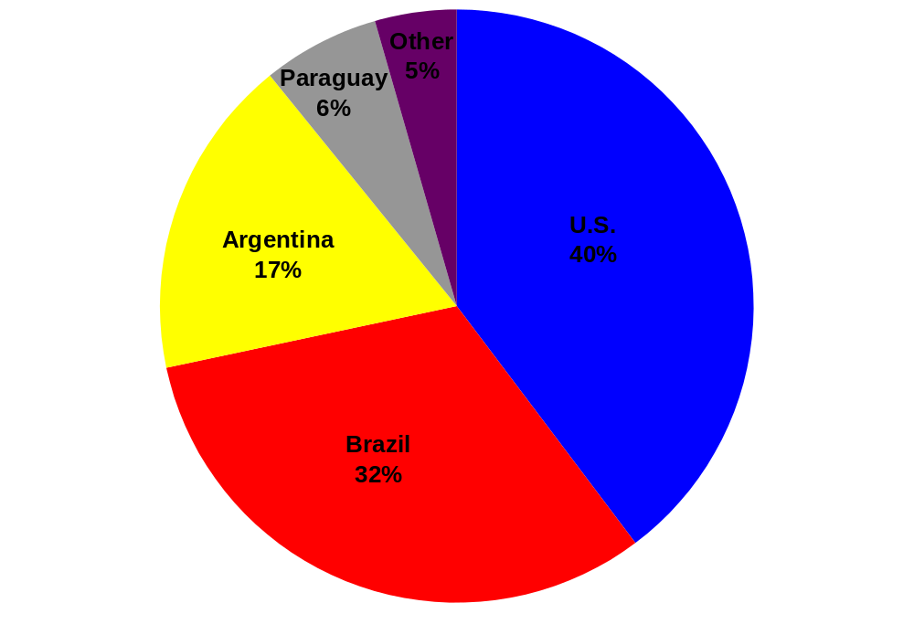
2007 World Soybean Exports
Drought issues
for 2008 crops
Source: USDA, FAS

Slide 27
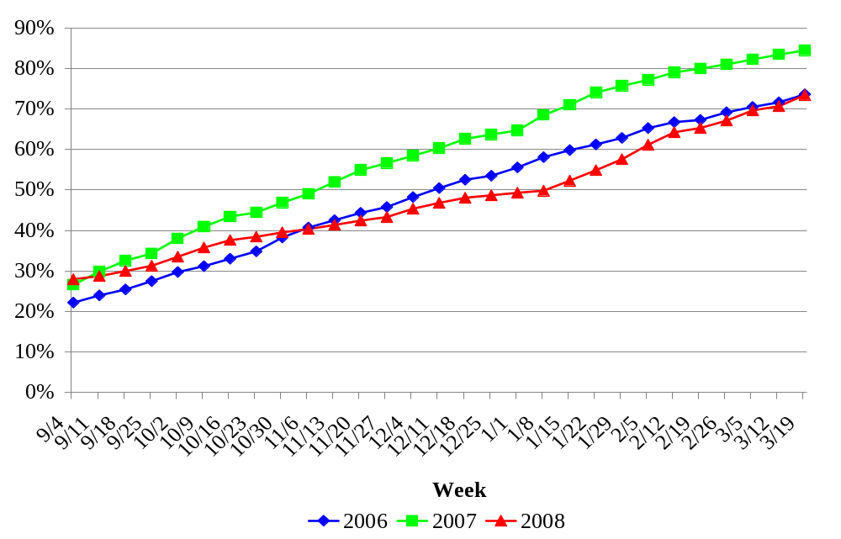
Pace of Corn Export Sales
Source: USDA, FAS

Slide 28
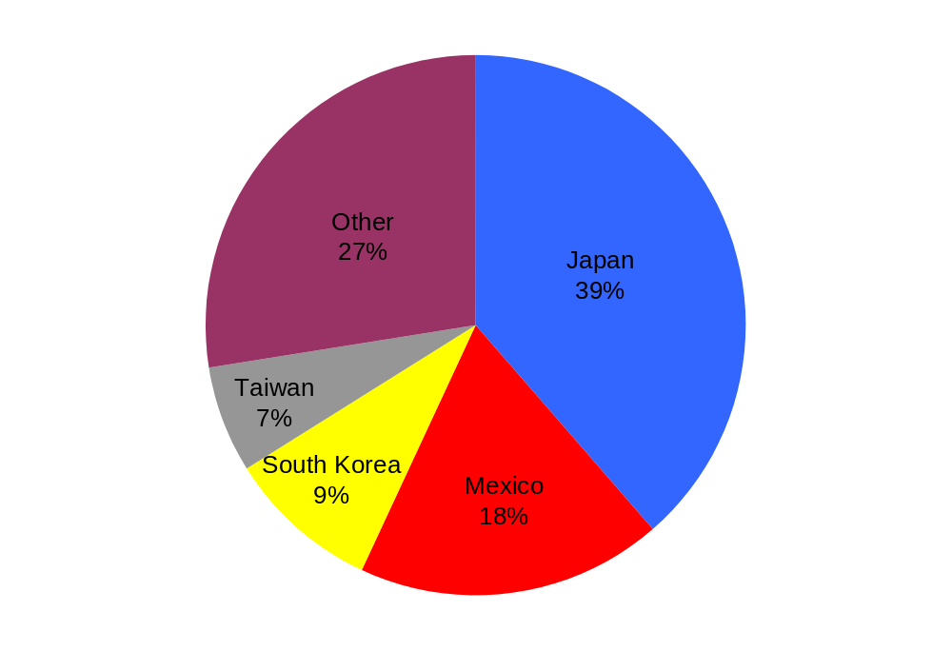
2008 U.S. Corn Exports
Source: USDA, FAS

Slide 29
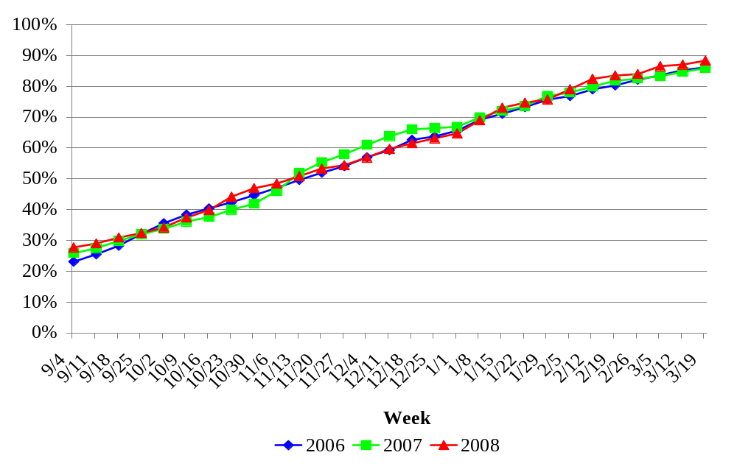
Pace of Soybean Export Sales
Source: USDA, FAS

Slide 30
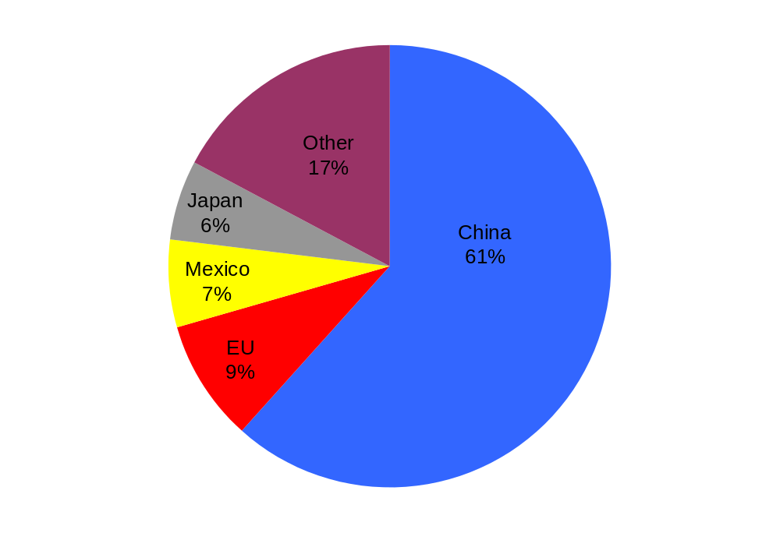
2008 U.S. Soybean Exports
Source: USDA, FAS

Slide 31
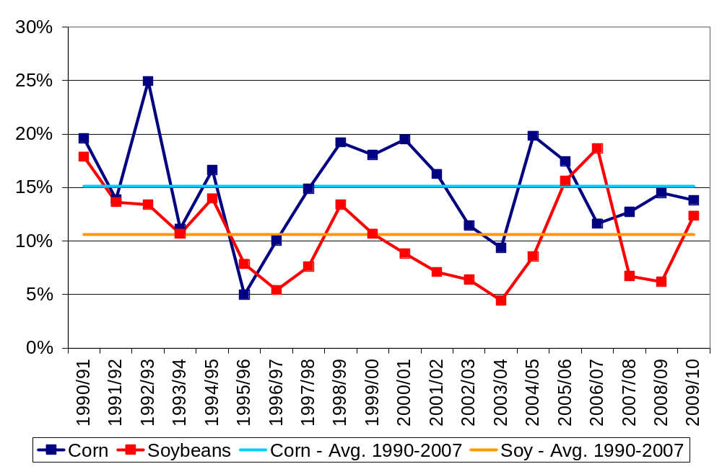
U.S. Stocks-to-Use Ratios

Slide 32
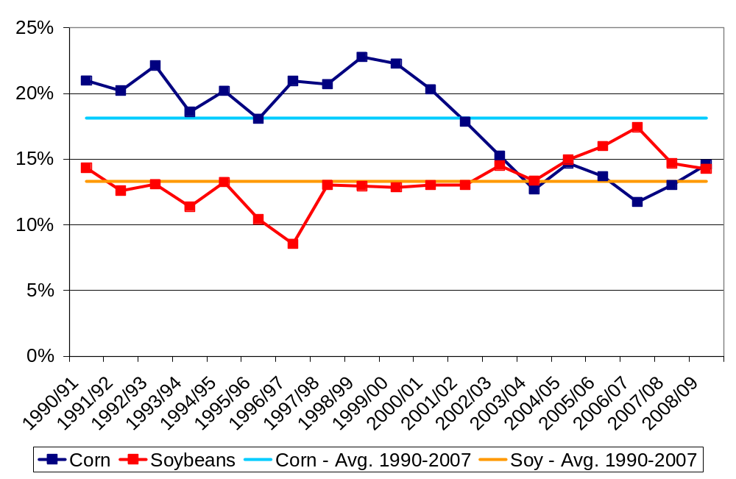
World Stocks-to-Use Ratios

Slide 33
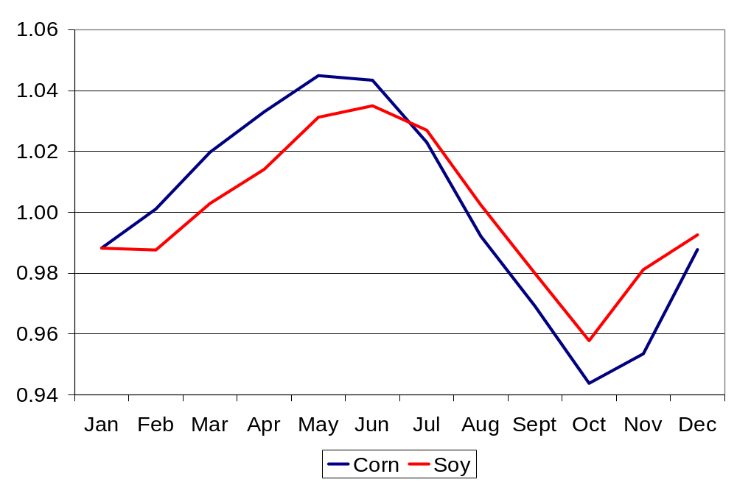
Seasonal Pricing Patterns
Source: USDA, NASS,
Monthly Price Data 1980-2008

Slide 34
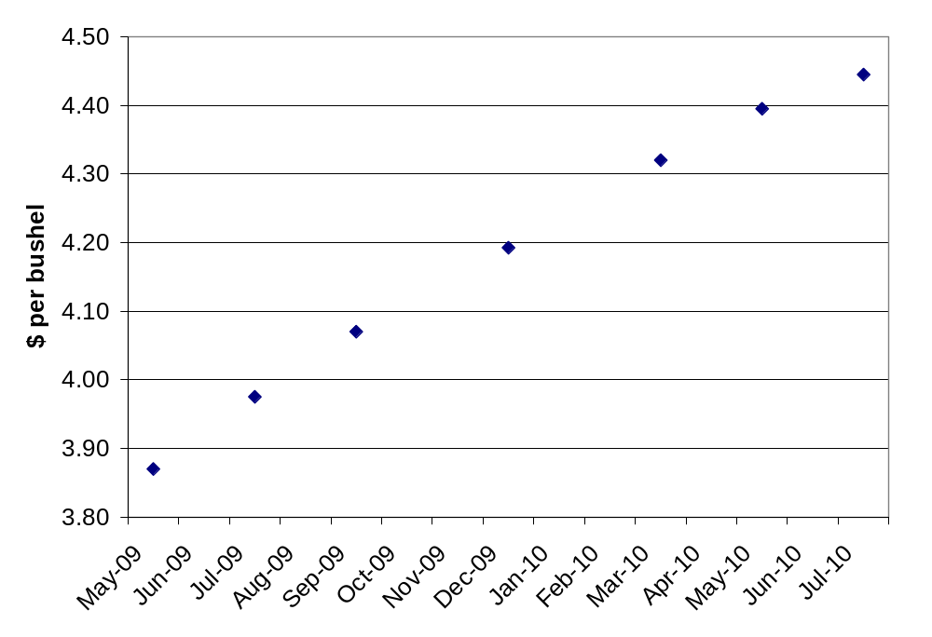
Corn Futures
2009 Rev. Ins. Price $4.04
Source: CBOT, 3/27/09

Slide 35
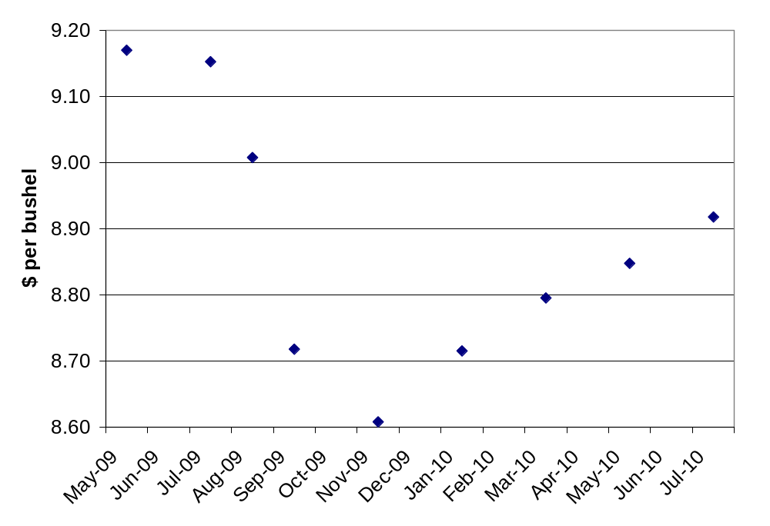
Soybean Futures
2009 Rev. Ins. Price $8.80
Source: CBOT, 3/27/09

Slide 36
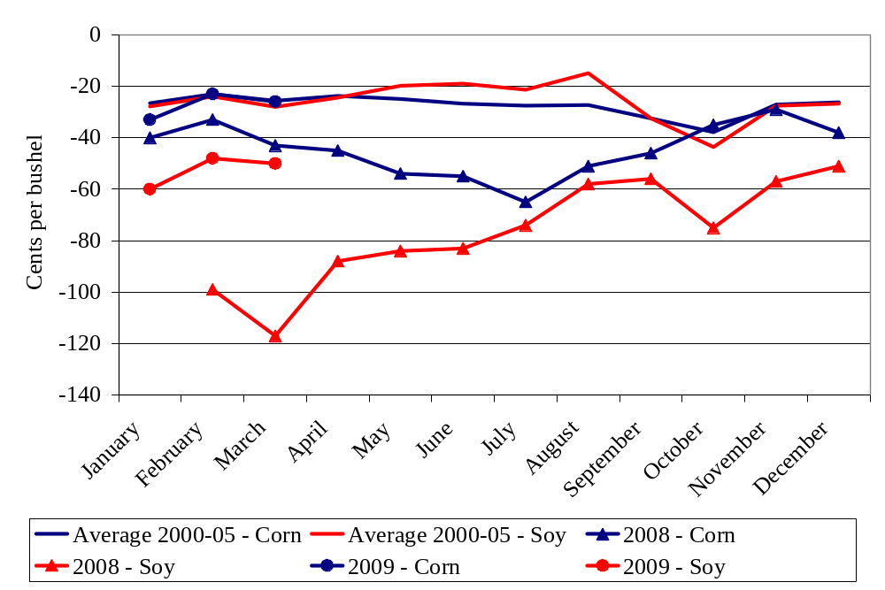
Basis

Slide 37
Finishing Out the 2008 Crop Year
General economic conditions
  A lot of recent market trade has been tied to reaction to the financial crisis and the world’s response
  Economic slowdown raises concern about export and energy demand
Most important ag. statistic: U.S. acreage estimates
Current futures are indicating 2008 season-average prices in the neighborhood of $4.15 for corn and $9.40 for soybeans
  Forward contracted grain helping hold up 2008 prices

Slide 38
Thoughts for 2009 and Beyond
Many of the storylines from 2008 will continue
  The competition for acreage
  Ethanol’s buildout & livestock’s adjustment
  Energy price & general economy concerns
Market volatility will remain high
  Link to the energy markets
  More market players with different trading objectives
USDA’s preview for 2009 is for crop prices around $3.60 for corn and $8.00 for soybeans
  Key factor: When does economic growth return?
  Current futures Last Friday: Corn $3.97, Soy $8.24

Slide 39
Thank you for your time!
Any questions?
My web site: http://www.econ.iastate.edu/faculty/hart/
Iowa Farm Outlook: http://www.econ.iastate.edu/outreach/agriculture/periodicals/ifo/
Ag Decision Maker: http://www.extension.iastate.edu/agdm/

